Slide 1

Admissions+
A guide for Lipa Sixth Form applicants

Slide 2
Follow this link:
LIPA Sixth Form College (applicaa.com)
Your login details have been sent to your school/personal email account.

Slide 3
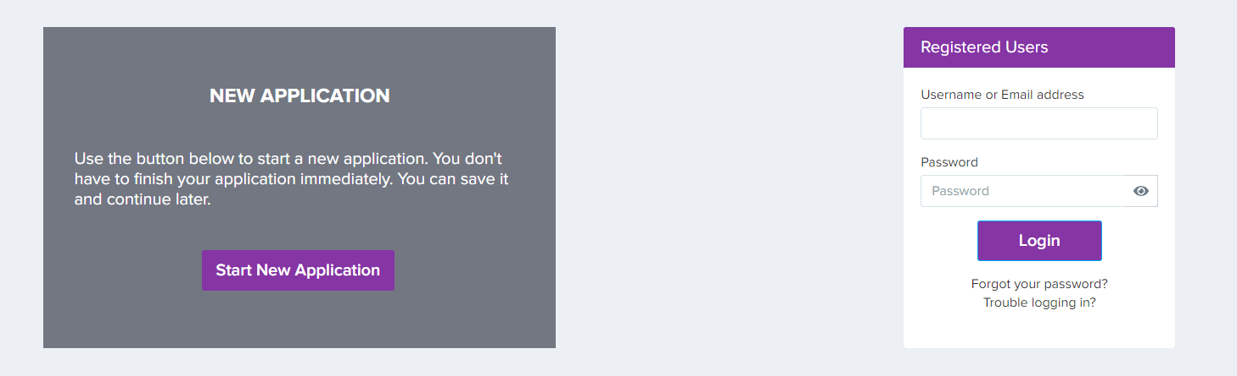
This is for EXTERNAL applicants only
Add your email address and password here and login as a Registered User

Slide 4
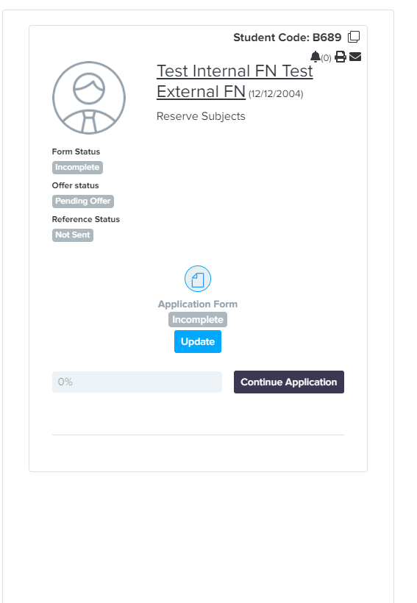
Once you’re logged in…
You will see a welcome message and the option to “Continue Application”
Click the button to open your application and begin completing each section
Make a note of your password (set it to something memorable!) as you will need to log in again in future to view your interviews and offers

Slide 5
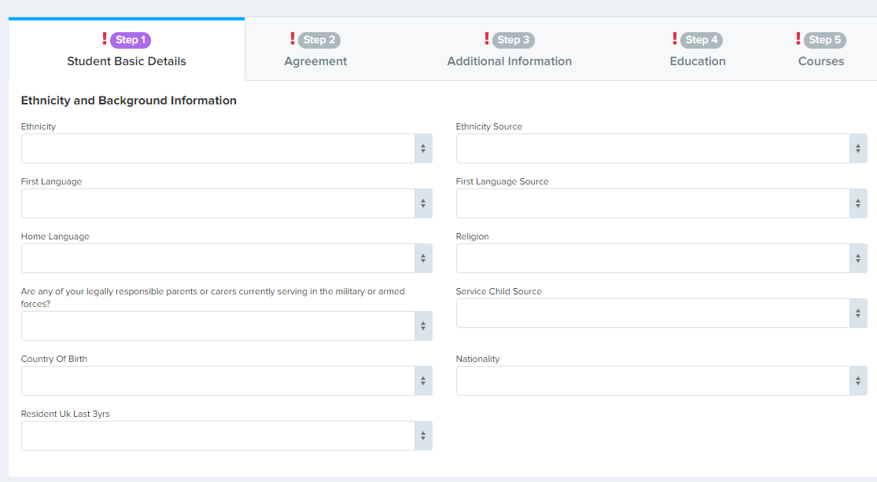
Press “save” at the end of each section
You don’t have to complete your application all in one go

Slide 6

If you have any questions or need any support:
Please contact
Julie Humphreys
Admissions Officer
admissions@lipasixthformcollege.org
0151 330 3232
LIPA SIXTH FORM COLLEGE, UPPER DUKE STREET, LIVERPOOL, L1 9DZ

